Slide 1

Year 9 Options Information Evening 2026

Slide 2
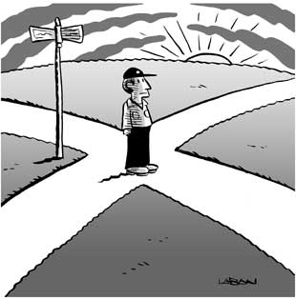


Slide 3

Purpose of the Evening
To outline the opportunities available in years 10 and 11
​
To explain the options process and how we will help with it ​
​​
To provide you with an opportunity to raise any queries​

Slide 4
Year 9 Options
Choosing the right courses now is the key to:​
  How students will engage with their next two years ​
  Their chances of achieving excellent qualifications​
  Future courses, employment and potentially, salary​
We really want to help our students successfully achieve their future career, job and life aspirations.​

Slide 5


Slide 6
The Core Curriculum
GCSE
English (Language and Literature GCSEs)
Mathematics
Science - either
  Combined Science (worth 2 GCSEs)
  Separate Science (Biology, Chemistry and Physics worth 1 GCSE each).
Core
RPE
PDE (applications, work experience, PSHE)
PE (including Sports Leaders Award and continuation of core PE offer)

Slide 7



HOW TO MAXIMISE GRADES
Work Hard in all Lessons!
Completion of homework on the Sparx platform and any other revision tasks set to be completed.
Make sure they have the correct equipment with them for their learning eg iPad fully charged / Maths Equipment
Setting a routine at home where work and revision can be completed. Ideally a quiet space
Encourage reading every day, this will help in all subjects

Slide 8
Year 9 Option Choices
It’s time to decide what subjects to study in Years 10 and 11 (key stage 4)
  GCSEs
    In subjects that students know, or ‘new’ subjects
  Technical or Vocational subjects

Slide 9
What do students choose?
Students have 4 option ‘choices’, within the guidance provided by the school
To help get the best results in Year 11 and to make the decision easier we will guide students onto the most appropriate pathway
This is based on thorough analysis of current levels, target grades and forecasted grades in the context of past trends.

Slide 10
Purple Pathway
  Some students will be guided to the EBacc (English Baccalaureate)
    This is a combination of:
    A Humanity (either Geography or History)
    A Language
The Government are keen to see as many students as possible leave with GCSEs in these subjects, but we know this combination does not suit everyone; we only guide students who we are confident will achieve at least a 5 in each of these subjects onto this pathway.
Students who are not on this pathway can still choose this combination if they wish.

Slide 11
Guidance – Purple Pathway
  If we think students have a very strong chance of doing well at all the EBacc subjects, we will guide them to do Geography or History plus a Language.
  This will then leave them with 2 more ‘free’ choices from the list (which can include any subject they didn’t tick as choice 1 or 2)

Slide 12
Orange Pathway
To make sure all Jack Hunt students have a balanced set of courses we make sure that everyone chooses at least one EBACC subject to go with their English, Maths and Science.
This way everyone will leave with a broad set of subjects that people will be looking for:
French, Spanish, Urdu
Geography, History
This leaves students with 3 more choices to make

Slide 13
Orange Pathway
Students will need to tick one of the subjects from box 1 leaving 3 free choices
These free choices can be a subject they didn’t tick as choice 1, or any other subject.
It may even result in them choosing a combination that matches the EBACC pathway anyway!

Slide 14
Pathways - a summary
PURPLE (EBacc) - 1 Humanity, 1 Language,
any 2 others
ORANGE - 1 from the EBacc list,
any 3 others

Slide 15
Optional GCSEs at Jack Hunt School
  Art and Design – Fine Art
  Art and Design - Graphic
  Communication
  Business Studies
  Citizenship
  Design and Technology
  Drama
  Geography
  History
  Ancient History
  Language*
  Music
  RPE
  Separate Science*
  Sport Science
  Sociology
Students would not have experienced Subjects in red during KS3.

Slide 16
*Separate Science
  This is where students study Biology, Chemistry and Physics separately and in more depth.
  There is not enough time in the Science timetable slot to cover all three subjects, so Separate Science takes up one option choice.
  Invited students only (based on attainment in Science and Maths in Year 8 & 9).
  If invited it is not compulsory.

Slide 17
*Languages
Global community and speaking an additional language can be very beneficial and lots of employers are looking more and more at this
Learning a language can also help with general communication and inter-personal skills, cultural awareness and public speaking therefore developing confidence.
Part of the EBACC set of qualifications
We believe you will get an excellent outcome. Languages students do very well!
There is a Key Stage 5 Language pathway at JHA

Slide 18
Language Qualifications
  Sometimes students speak another language fluently and they may be able to sit a GCSE in that language.
  When students complete their option choices there will be a question asking them about additional languages spoken

Slide 19
Technical or Vocational subjects at Jack Hunt Academy
The final grade is mainly based upon ongoing classwork/coursework (60%) projects. There are fewer exams involved (approximately 40%)
Cambridge National in Sport
Cambridge National in Health and Social Care
Cambridge National in Information Technologies
WJEC Level 1/2 award in Hospitality and Catering
NCFE Music Technology

Slide 20
Inclusion Base
Alternative Support Route
Students who follow ALTERN8 will work in smaller groups where they can also focus on overlearning of core GCSE subject content
5-hour block spread across 2-week cycle
ASDAN offers a range of nationally approved qualifications based around the development of personal, social and employability skills:
Preparation for Adulthood / Life skills
Support with P16 applications
Y11 Revision support and planning
Overlearning of GCSE content
Personalised support package

Slide 21



ASDAN Awards
There are three awards that you can achieve through the Personal Development Programmes – Bronze, Silver and Gold.
You can progress from Bronze to Silver and Gold by completing more challenges over time and earning credits.

Slide 22



Slide 23
Confused?
Help is at hand….
  Year 9 Parents’ Evening
  PDE lessons
  Year 9 Options Booklet
  Personal Tutor
  Head of Year/ Dep Head of Year
  Subject teachers
  Year 9 'New Subject' Assembly
  Reports
Mr Piper
Independent Careers Support is available this evening.
Please see him for any conversations about subjects / possible future career choices and courses that would support these

Slide 24
General Advice
Talk to people
Listen to advice
Start researching online
Remember it’s for 2 years
Plan ahead
Our main aim is to get the best set of qualifications possible
Don’t base choices on favourite teachers
Don’t base choices on what friends are doing

Slide 25
Summary
Make 4 choices – guided choices and 'free' choices
Only choose Separate Science if you are invited
Don’t choose Technical or Vocational subjects and GCSEs in the same subject e.g. Sport Science and Cambs Nat PE / Ancient and Modern History
Avoid more than two Technical or Vocational subjects due to the heavy coursework element
Subject staff may decide which course is best, e.g. VOCATIONAL or GCSE
Make two reserve choices
If you are fluent in another language, tell us when you do your online form as we may be able to support you to gain an additional qualification

Slide 26
Next?
Make your final choices (plus two reserve choice in case we can’t get all 4 to fit on the timetable together)
Discuss this with your parents, teachers and personal tutor

Slide 27
And then?
Complete your option form at the back of your booklet
Deadline – Friday 13 February.
PARENTS AND TUTORS WILL NEED TO SIGN THE FORM. THIS IS REALLY IMPORTANT!

Slide 28

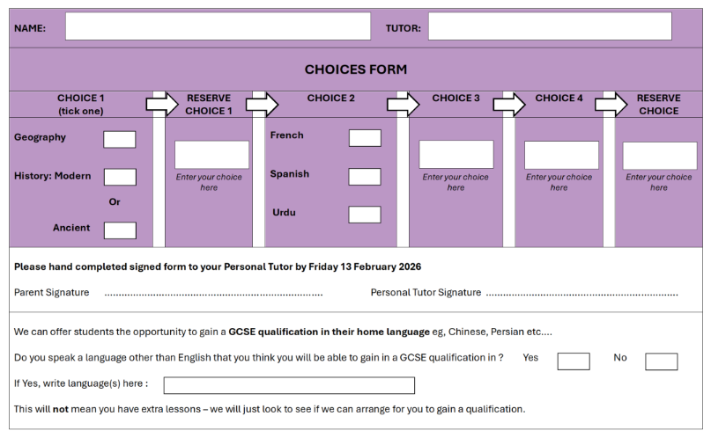
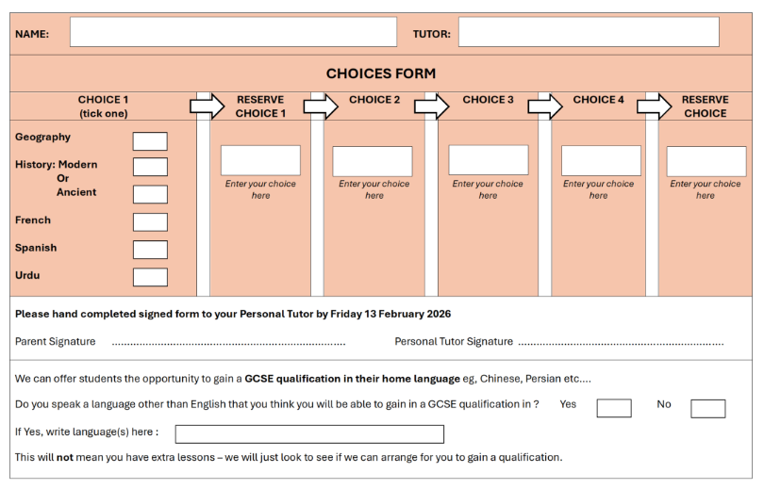
PURPLE
ORANGE

Slide 29
Please remember…
STUDENTS CANNOT CHANGE THEIR MIND ONCE THEY HAVE
STARTED YEAR 10!

